Slide 1
Іван Айвазовський Пейзажі

Slide 2
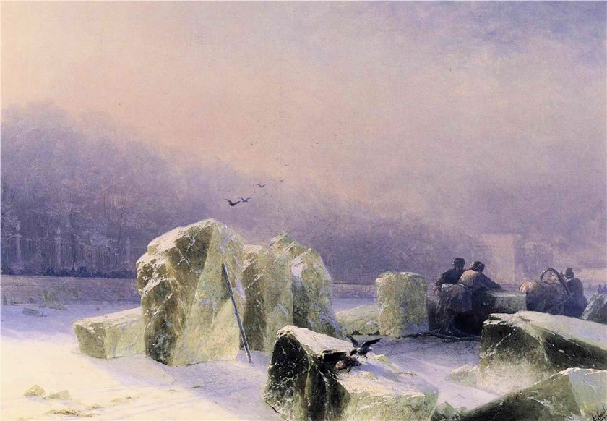
Айвазовский Иван Константинович.Ivan Constantinovich Aivazovsky - Ice-Breakers on the Frozen Neva in St. Petersburg.

Slide 3
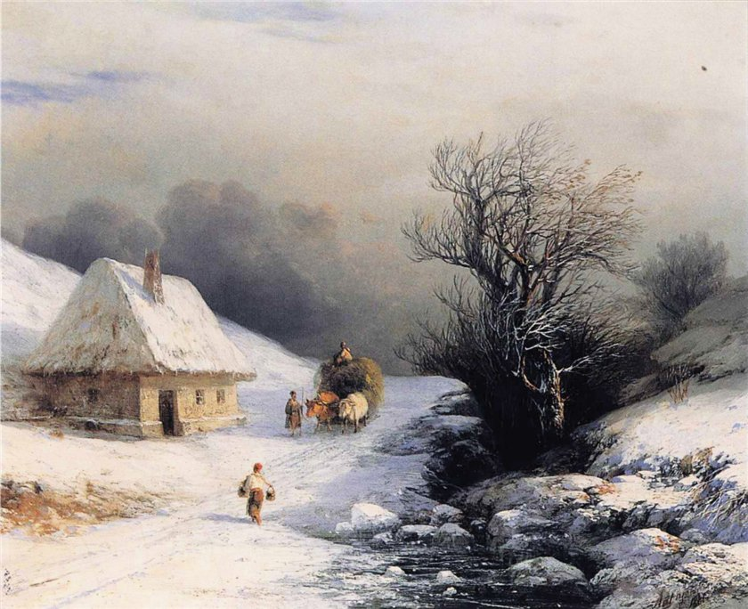
Ivan Constantinovich Aivazovsky - Little Russian Ox Cart in Winter.

Slide 4
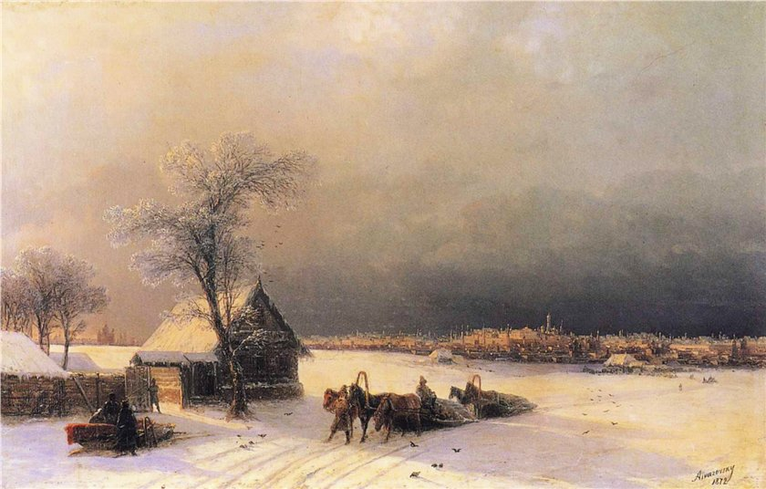
Ivan Constantinovich Aivazovsky - Moscow in Winter from the Sparrow Hills.

Slide 5
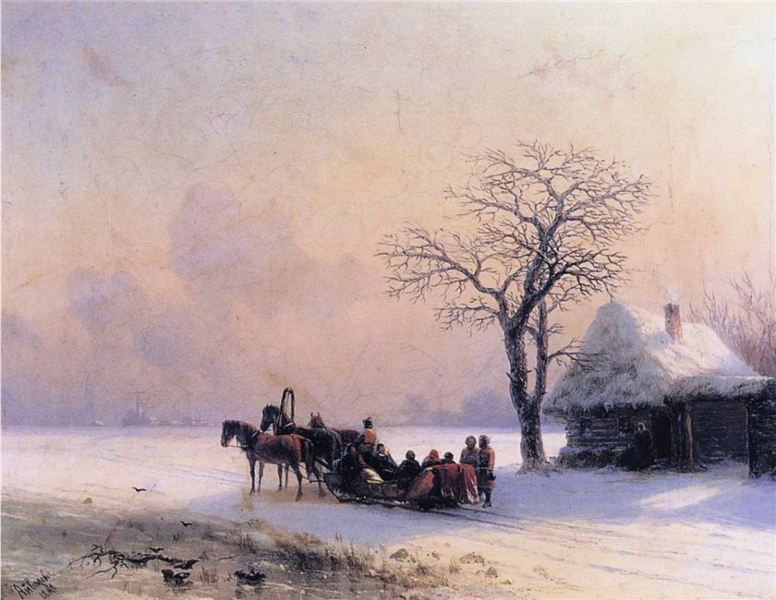
Ivan Constantinovich Aivazovsky - Winter Scene in Little Russia.

Slide 6
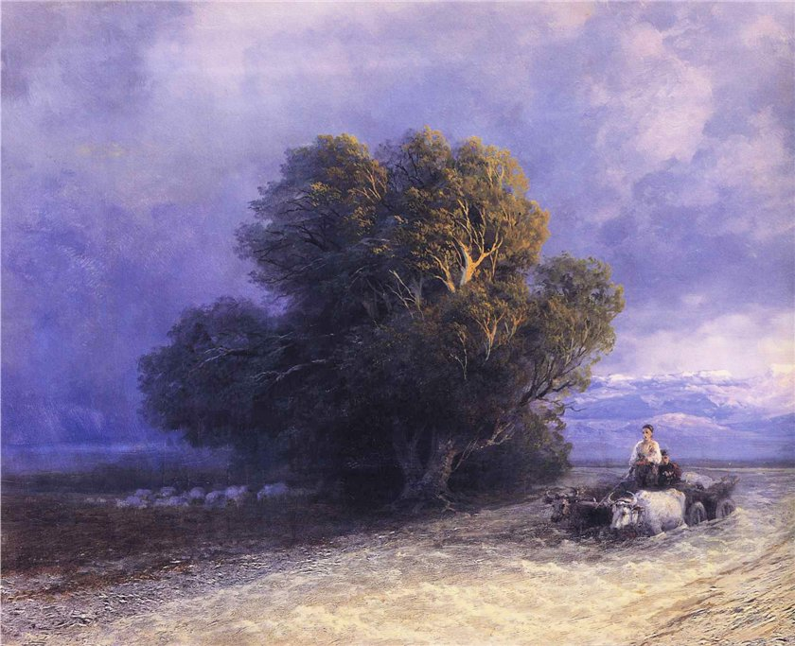
Ivan Constantinovich Aivazovsky - Ox Cart Crossing a Flooded Plain

